Slide 1
OSS Risk Management Service in Fujitsu
2018/9/13

Slide 2
OSS Total Service in Fujitsu
We strongly support all processes involved in OSS application in all aspects.
Planning
Design
Introduction
Operation
Risk management services to introduce open source safely and securely
Risk Assessment
Extraction of risks
Setting of goals to be aimed at customers’ current operation
Policy/Rule Formulation
Risk Management Tool Introduction
support for creating operation policy and whitelist
Q&A Service
Response to various consultations on risk measures
Risk Management Tool Selection
Technical services to realize further utilization of OSS
Utilization Assessment
Formulation of OSS usage policy for each service level of the system
Selection Assistance
Selecting optimal OSS according to requirements
Introduction
on behalf of customers
Technical Support
Technical QA support
solution support at the time of trouble occurrence
Migration Assessment
Calculation of man-hours and difficulty
Migration
on behalf of customers
Highly Technical Support
Highly technical support, such as troubleshooting and performance tuning
Educational services to support customers’ in-house production
Training
Training courses about OSS, Skill Transfer

Slide 3



Functional overview of OSS Risk Management Tool
Realization of OSS lifecycle management
Visualize of OSS being used in your company
Link the visualized OSS with license information and known vulnerability
Make a list of software / version / license judged to be no problem as utilization in your company
Make the approval workflow for each process
Approval
Workflow
Manager
developer
Whitelist
Binary code
License
Information
Source code
Analyze
Link
Known
Vulnerability
（NVD、CVE）
VCS
（SVN,Git,etc.）
List of OSS being used
in your company

Slide 4






Selection support for Risk management tool
We collaborate with the developers of major risk management tools
We support optimal selection of risk management tools according to compatibility with requirement application and assets.
Product | Managed Object | Detection Target | Usage Form | Size of Knowledge base | Licensing System | Emerging or Incumbent
 | Source code | File Snippet | On-premises Cloud | Huge | Subscription (expensive) | Incumbent
 | Source code | File Snippet | On-premises | Moderate | Subscription (moderate) | Incumbent
 | Source code | File Snippet | On-premises Cloud | Huge | Subscription (expensive) | Emerging
 | Source code Binary | File | On-premises Cloud | Moderate | Subscription (inexpensive) | Incumbent
 | Source code | File | On-premises Cloud | Moderate | Subscription (inexpensive) | Emerging
 | Binary | File Snippet | On-premises Cloud | Moderate | Subscription (moderate) | Emerging

Slide 5
Comparison of OSS Security Tools
Black Duck
Flexera
WhiteSource

Slide 6
Background – how to choose the tool
We recommend to conduct enough benchmarks of OSS security tools before introduction.
Functions of each tools are different*, so you need to consider which tool meets your needs.
*detection algorithms, knowledge base fulfillment level, billing system etc.…
There is no compatibility among the tools.
It costs very much for tool migration after the introduction.
We support optimum tool selection
by theoretical or real machine* benchmark test.
* Evaluate detection rate and false detection rate
by assigning part of your resources to actual tools

Slide 7
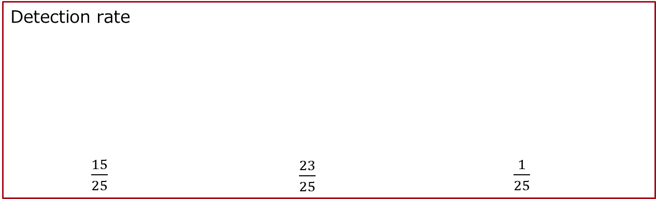
(Reference) Our benchmark case
Target :C++ program(20K steps) and related binary code
Duration :about 1 month
Target | Suspicions detected by the tool | No matter * judged by our survey | Concerns about license violation | Number of OSS included in target program
C++ Program | 6.128 | 6.177 | 11 | 25
Clearance of erroneous detection by hand takes a lot of man-hour.
Therefore, this can be one of the evaluation axes.
Detection rate
$\frac{15}{25}$ $\frac{23}{25}$ $\frac{1}{25}$

Slide 8


Comparison of tools
Product
History | Long 2003: Founded 2017: Acquired by Synopsys | Long 1987: Founded 2008: Founded Japan office 2016: Acquired by Palamida | Emerging 2017: Founded
Managed object | Source code | Source Code | Source Code
Detection target | File Snippet | File Snippet | File
Detection frequency | Automatic for each build | Regularly | Fully automatic for each build
Usage form | On-premise Cloud | On-premise | On-premise Cloud
Knowledge base size | 2 million projects | 13 million projects | 300 million projects
Licensing system | Subscription (Expensive) | Subscription (Medium) | Subscription (Inexpensive)
Database update frequency | Weekly | Biweekly or monthly ※not regular | Daily
System requirements | CPU: 64 bits 4 cores or more Memory: 12 GB or more HDD: 100 GB or more OS: Linux | CPU: 64 bits 2.4 GHz or more Memory: 16 GB HDD: 750 GB or more OS: Red Hat Enterprise 5, Cent OS 5, Windows Vista Ultimate, Windows 7 Ultimate, etc...* All 64 bit version only | Java - JRE 8 WildFly 10.0.0-Final MySQL 5.7 OS: Ubuntu Server 14 or more, other Linux-based OS CPU: 2 Core, 2GHz or more RAM: 8GB or more Storage:1TB or more

Slide 9
Prices
Product
Fujitsu's Handling | introduce group company | introduce sales company | introduce group company
Installation support | 〇 | 〇 | 〇
Billing system | Source code size | Number of developers | Number of developers or registered products
Minimum price | 5Gbyte~ \12,000,000 | \4,500,000~ | Cloud:\1,100,000~(*)
Case: 100 developers | - | \13,500,000~ | Cloud:\7,570,000~(*)
Case: 500 developers | - | \36,000,000~ | Cloud:\33,840,000~(*)
(*) In case of on-premises use, about 4 million yen is required for additional

Slide 10
(Reference)
Information of target vendors, products, and versions
Vender | Target Product | Target Version
Black Duck Software | Black Duck Hub Black Duck Protex | 3.4 7.5
Flexera | Palamida Enterprise Edition | 6.10.3
Sonatype | Nexus IQ Server Nexus Lifecycle Nexus Firewall Nexus Auditor Nexus Repository Pro | 1.23 1.23 1.23 1.23 3.1
Synopsys | Protecode Enterprise Protecode Supply Chain | 5.2 Fronted 20161114-0745 Worker:20161114-0646-7e01d69
Veracode | Veracode Software Composition Analysis | 2016.8
WhiteSource Software | Open Source Lifecycle Management | 16.3

Slide 11
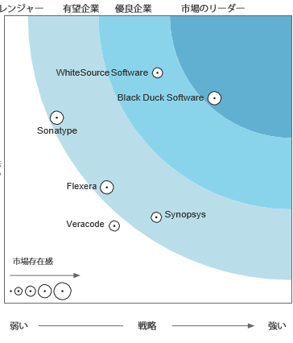
(Reference)
Software Composition Analysis by Forrester Wave
(First quarter of FY2017)
Challenger
Promising
Excellent
Leader
Strong
Product
Presence in the market
Weak
Weak
Strategy
Strong

Slide 12
OSS Maturity Evaluation Report

Slide 13
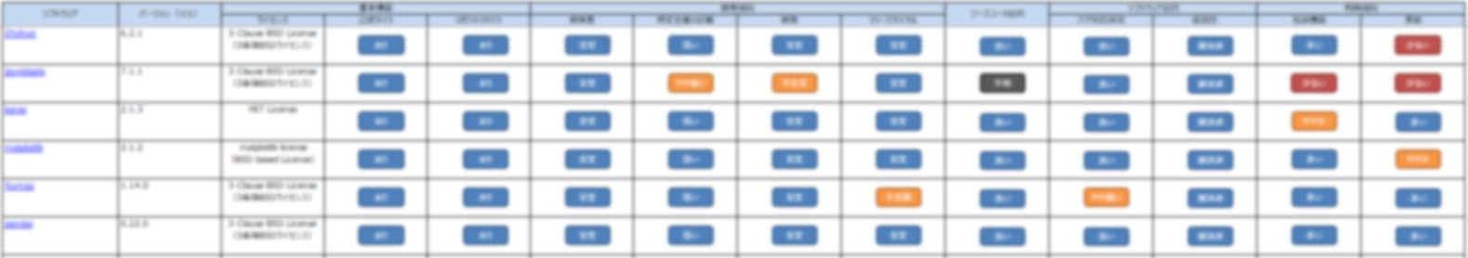
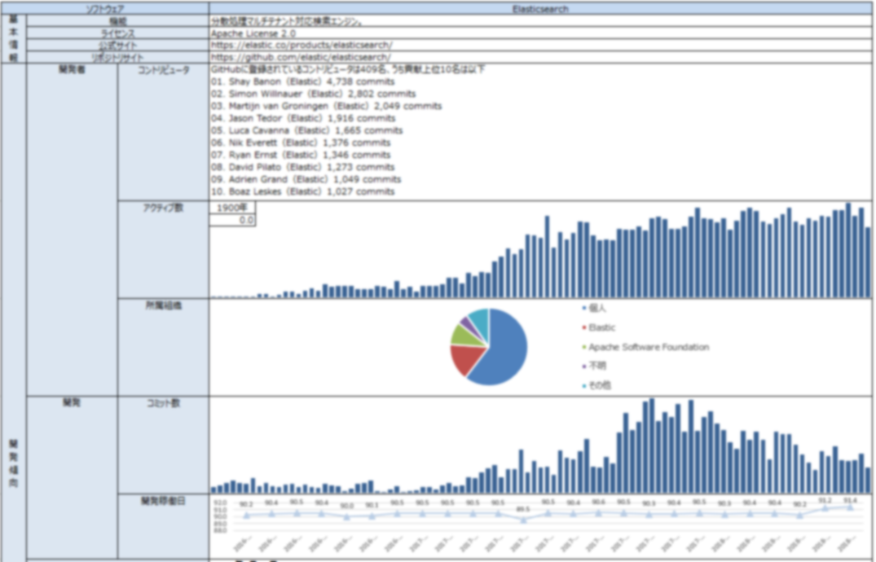

OSS Maturity Evaluation Report
Periodically evaluate and report maturity of OSS that you are using or are considering using.
Maturity is evaluated in 3 levels for 11 axes.
Safe
Caution
Warning
Click software name to display more detailed report

Slide 14
Example of maturity evaluation axes (1/2)
Maturity Evaluation Axes |  | Detail
Basic Information | License | License applied to that OSS. Especially, pay attention when licensing differs depending on version or component.
 | Official Site | Whether the official site exists.
 | Repository Site | Whether the repository site to manage source code exists. When the source code is released at repository site (ex. GitHub), developers and development trend can be visualized.
Development Trend | Developers | Whether the number of developers is stable. If the number is suddenly increasing or decreasing due to acquisitions etc., follow-up observation is necessary.
 | Influence of a specific company | The influence strength of a specific company. If a specific company holds many copyrights, there is a possibility of changing development policy only with the speculation of the company.
 | Commits | Whether the development itself is stable.
 | Releases | Whether the OSS make releases regularly.

Slide 15
Example of maturity evaluation axes (2/2)
Maturity Evaluation Axes |  | Detail
Source code quality |  | Quality of source code itself. Evaluate complexity etc. as metrics for measuring readability and maintainability.
Software quality | Correspondence to bugs | Whether the bugs are managed and visualized, and they are corresponded.
 | Vulnerability | Whether the fixes for serious vulnerability made quickly.
Use trend | Technical information | The degree of fulfillment of the official documents, books, presentation materials, and so on.
 | Use cases | Whether there are cases of introduction in companies.

